Slide 1
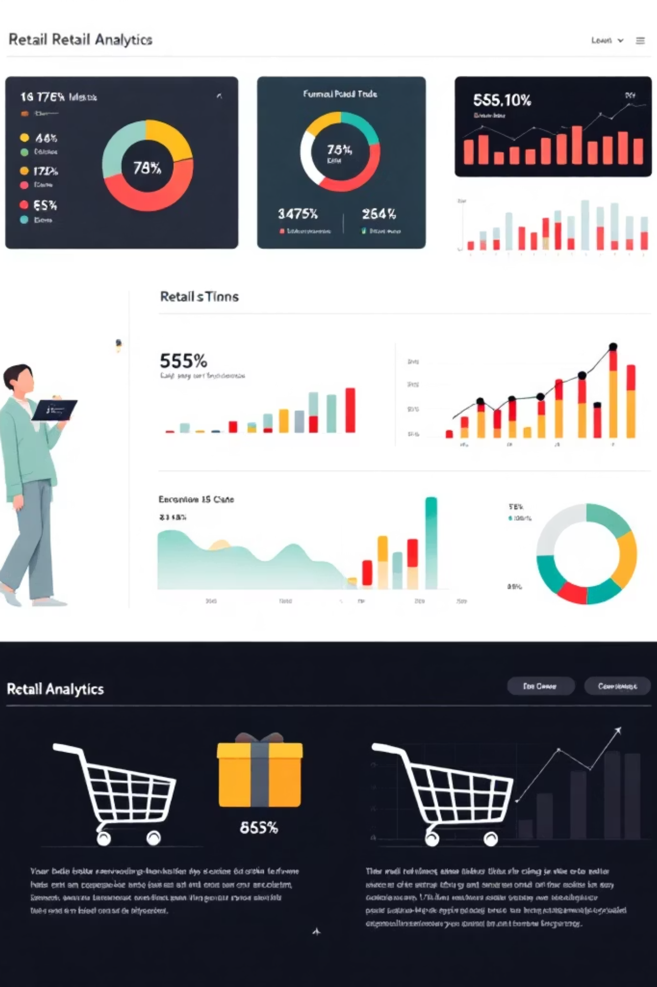
Customer Shopping Behaviors Analysis
Uncovering insights from 3,900 customer transactions to guide strategic business decisions through data-driven analysis of spending patterns, customer segments, and product preferences.

Slide 2

OVERVIEW
Project Scope & Data Foundation
Dataset Overview
Analyzed 3,900 transaction records across multiple product categories from a publicly available GitHub repository with 18 key features.
Demographics
Purchase Details
Age, gender, location, subscription status
Item, category, size, color, season
Behaviors
Ratings, shipping, discounts, payment methods

Slide 3
DATA PREPARATION
Data Cleaning & Feature Engineering
01
02
03
Missing Values
Standardization
Age Segmentation
Imputed review ratings using median within each product category to minimize outlier influence and maintain realistic sentiment patterns.
Renamed columns to snake case for better readability and documentation consistency across the dataset.
Created age_group using quantile-based binning into 4 categories: Young Adult, Adult, Middle-Aged, Senior for clearer analysis.
04
05
Purchase Frequency
Data Consistency
Converted categorical frequency values to numerical days between purchases, enabling customer segmentation and revenue analysis.
Dropped redundant promo_code_used column as values duplicated discount_applied, streamlining promotional impact analysis.

Slide 4
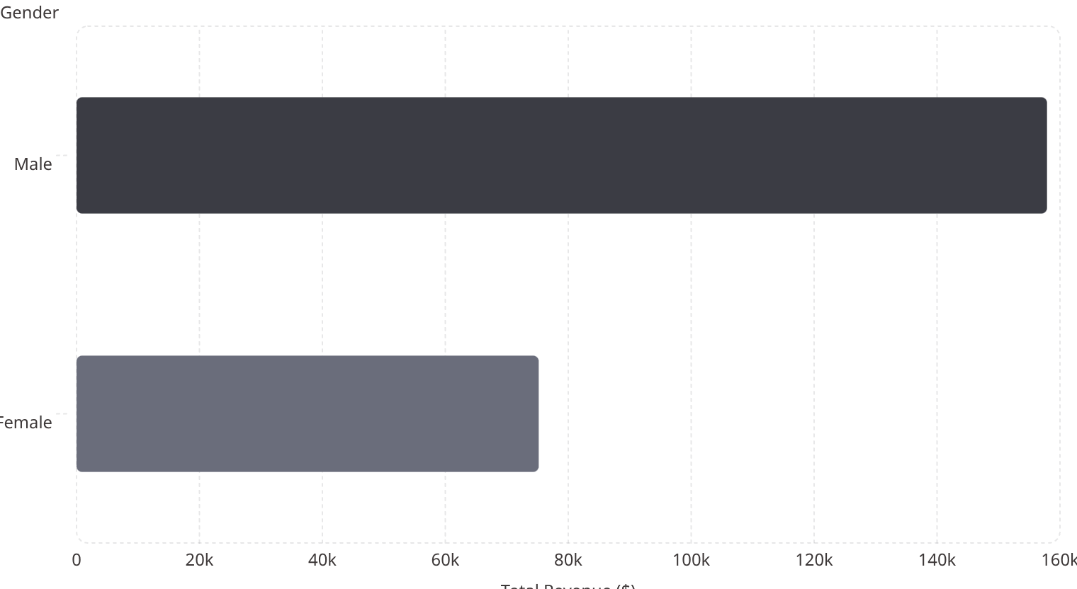

GENDER ANALYSIS
Revenue by Gender: Male Dominance
Key Finding
Male customers generated roughly twice the total revenue compared to female customers, highlighting their disproportionate contribution to overall revenue.
Strategic Implication: Target high-value male customers with personalized promotions to further increase revenue potential.

Slide 5

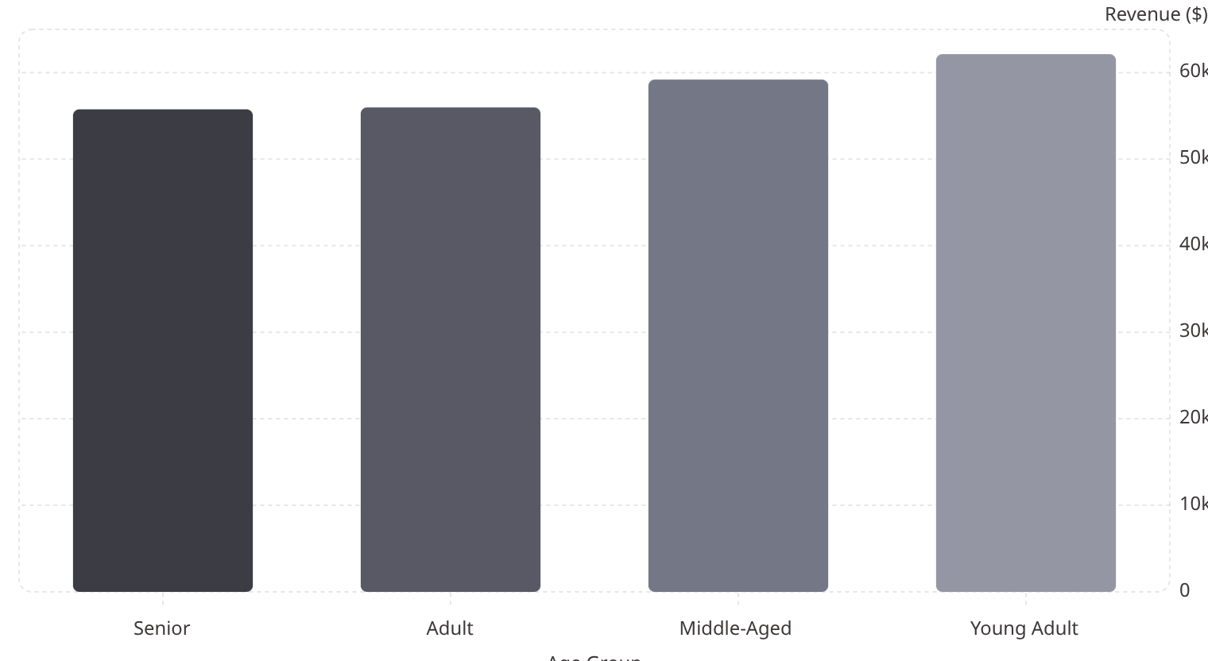
Revenue by Age Group: Young Adults & Middle-Aged Lead
Young Adult and Middle-Aged segments account for the largest share of total revenue, making them key target groups for marketing and promotional strategies. Personalized offers and loyalty programs targeting these segments are likely to have the greatest impact on revenue growth.

Slide 6
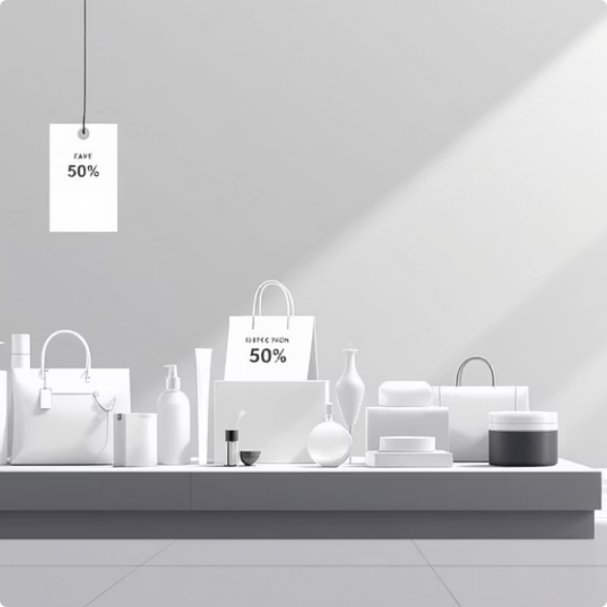
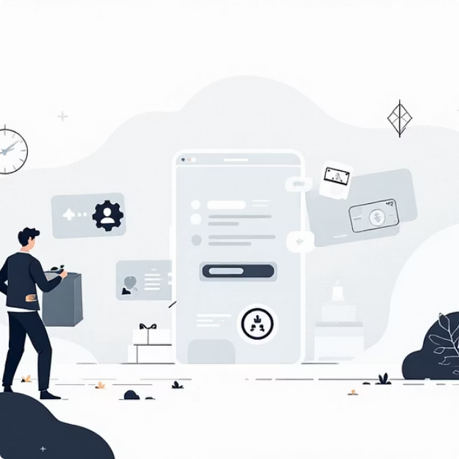

CUSTOMER INSIGHTS
High-Value Customer Behaviors
High-Spending Discount Users
Subscriber Value
Repeat Buyers
Customers who applied promo codes but still spent above average represent high-value buyers motivated by product preference rather than discounts. These 15+ customers spent between $62-$97 per transaction.
Subscribed customers make up less than one-third of the customer base (1,053 vs 2,847) but spend nearly as much per transaction ($59.49 vs $59.87), indicating high-value status despite lower numbers.
Most customers with more than five prior purchases (2,518) are not subscribed, representing a significant conversion opportunity for subscription programs and enhanced loyalty benefits.

Slide 7
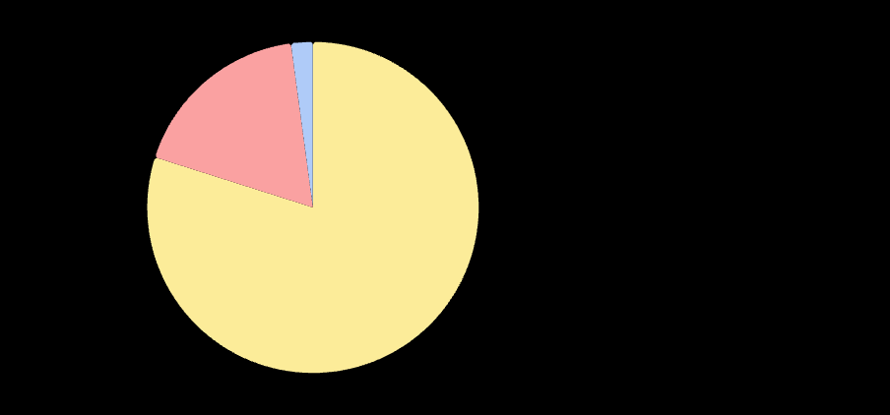
Customer Segmentation: Loyalty Dominates
3.9k
Loyal Customers
New
Returning
Nearly 80% of the customer base, underscoring the critical importance of retention strategies and continued engagement.
Loyal·79.9%
·79.9%
·
Returning·17.97%
·17.97%
·
New·2.13%
Returning Customers
·2.13%
·
Represent a key growth opportunity with targeted campaigns to increase purchase frequency and lifetime value.
Loyal
New Customers
Low proportion highlights the urgent need for targeted acquisition campaigns to expand the customer base.

Slide 8


PRODUCT PERFORMANCE
Top-Rated & Best-Selling Products
Highest Review Ratings
Top 3 by Category
3.86
Accessories
Clothing
Gloves
Jewelry (171), Sunglasses (161), Belt (161)
Blouse (171), Pants (171), Shirt (169)
3.84
Sandals
Footwear
Outerwear
3.82
Sandals (160), Shoes (150), Sneakers (145)
Jacket (163), Coat (161)
Boots
3.80
Hat
3.78
Handbag
These products reflect strong customer satisfaction and should be promoted through marketing or bundle offers.

Slide 9







Strategic Recommendations
Target High-Value Males
Personalized promotions for male customers to increase revenue
Focus Key Age Groups
Marketing campaigns on Young Adult and Middle-Aged segments
VIP Programs
Upsell to customers who spend above average despite discounts
Convert to Subscribers
Campaigns to convert non-subscribers and repeat buyers
Promote highly-rated Products
Marketing or bundle offers to drive sales
Top selling Products within each Category
Prioritize inventory, promotions, and cross-sell opportunities for top-selling items in each category.

Slide 10
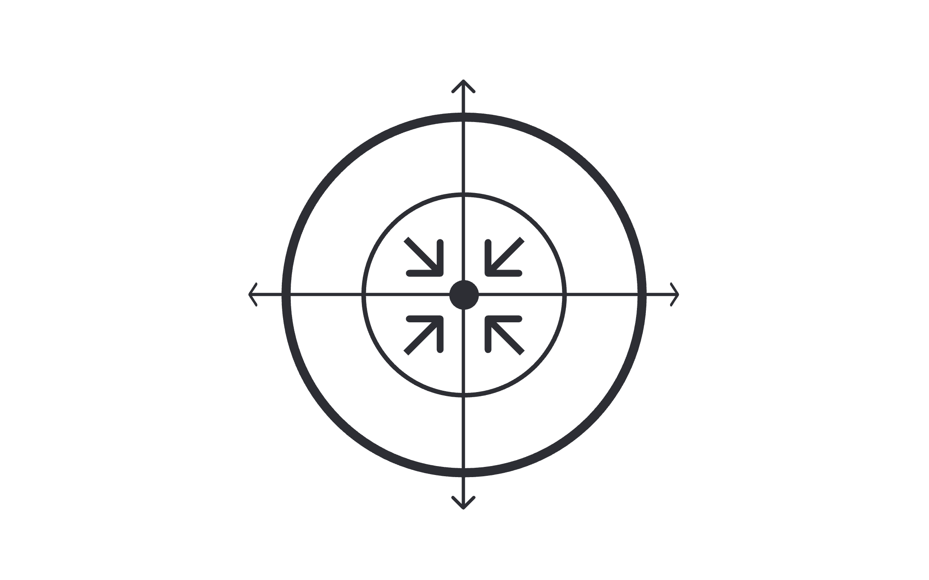

ACTION PLAN
Key Takeaways & Next Steps
Retention for Loyal Customers
Inventory for Best-Sellers
Acquisition Campaigns
Promote Top-Rated Products
By focusing on these strategic priorities, the business can maximize revenue from existing high-value segments while expanding the customer base through targeted acquisition. The combination of retention strategies for loyal customers, conversion programs for repeat buyers, and promotional efforts for top-performing products creates a comprehensive approach to sustainable growth.
Implementation Priority: Start with subscriber conversion campaigns for repeat buyers, as this represents the quickest path to increased customer lifetime value with minimal acquisition costs.

